Slide 1


CMR TECHNICAL CAMPUS UGC(Autonomous)
Kandlakoya,Medchal Road,Hyd-501 401 Department of Computer Science Engineering
Major Project On
SECURING THE DATA IN THE IMAGE USING SHA AND ECC
BATCH NO: 15
Project Guide : Batch Members :
Dr. D. T. V Dharmajee Rao 217R1A0571 B. Karthik Reddy
Professor & Dean Academics 227R5A0508 N. Madhu
217R1A05C2 S. Tanay Reddy
Project Coordinator :
Dr. J. Narasimharao
Associate Professor, CSE Department

Slide 2
TABLE OF CONTENTS
Use Case Diagram
Class Diagram
Sequence Diagram
Activity Diagram
Results
Conclusion
Future Scope
References
Github Link
Abstract
Existing System
Disadvantages
Proposed System
Advantages
Hardware and Software Requirements
Novelty of the Project
Architecture
Modules

Slide 3
ABSTRACT
In the digital age, the protection of sensitive information has become paramount, especially in the context of image data which is often used in various critical applications. This project explores a novel approach to securing image data through the integration of Secure Hash Algorithm (SHA) and Elliptic Curve Cryptography (ECC). SHA, known for its robust hashing capabilities, is employed to create a unique digital fingerprint of the image, ensuring data integrity and authenticity. ECC, on the other hand, provides a highly secure encryption framework with efficient key management and reduced computational overhead compared to traditional methods.

Slide 4
EXISTING SYSTEM
In the current digital landscape, securing image data is increasingly critical, especially with the growing usage of images in digital communications, medical records, surveillance, and online transactions. Traditional systems primarily rely on encryption methods like the Advanced Encryption Standard (AES) or the Data Encryption Standard (DES) for protecting data, including image files. These methods provide substantial security but may fall short against evolving threats such as quantum computing attacks,and are less efficient for resource-constrained environments like mobile devices.

Slide 5
DISADVANTAGES
1 . High computational overhead for traditional encryption.
2 . Inefficient for real-time applications.
3 . Limited scalability for high-volume image data.
4 . Vulnerability to quantum computing threats.
5 . Absence of integrated integrity verification.
6 . Complex key management.

Slide 6
PROPOSED SYSTEM
To secure data in an image using SHA (Secure Hash Algorithm) and ECC (Elliptic Curve Cryptography), the proposed system integrates these cryptographic techniques to enhance both data integrity and confidentiality. • First, the image data is hashed using SHA, which generates a unique, fixed-size hash value representing the image's content. This hash serves as a digital fingerprint of the image, allowing any modifications or corruption to be detected. The hash value is then encrypted using ECC, which leverages the elliptic curve to provide a high level of security with relatively small key sizes compared to other encryption methods. ECC’s efficiency ensures that the encryption process is both fast and resource-effective.

Slide 7
ADVANTAGES
Enhanced Security: SHA ensures integrity, and ECC provides strong encryption with small key sizes.
Efficient Processing: Faster encryption/decryption with minimal computational overhead.
Tamper Detection: SHA allows verification of data integrity.
Steganography-Based Data Hiding: Conceals encrypted data within an image.
Secure Communication: Protects sensitive data in image files.
Scalability: Suitable for various applications including secure messaging and Authentication

Slide 8
SYSTEM REQUIREMENTS
Hardware Requirements :
Processor : Intel Core i3 or above
Hard Disk : 40GB minimum
RAM : 4GB or above
Software Requirements :
OS : Windows 8 or above
Languages : Python
Backend : Django-ORM
Frontend : HTML, CSS, JavaScript

Slide 9
NOVELTY
This project presents an innovative approach to securing image data by integrating cryptographic hashing (SHA) and encryption (ECC) with steganography. The novelty lies in its multi-layered security framework, which enhances both confidentiality and integrity while maintaining efficiency
Key Novelty Aspects :
Dual-Layered Security
Integration of Cryptography with Steganography
Lightweight & Efficient Encryption
Tamper Detection and Integrity Verification
Quantum-Resistant Security

Slide 10
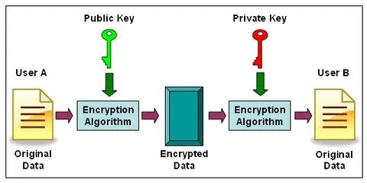
ARCHITECTURE

Slide 11
MODULES
User Authentication Module
Handles user registration and login.
Ensures secure access to encryption and decryption functionalities.
Encryption Module
Uses an encryption algorithm (e.g., SHA and ECC) to encrypt data using the public key.
Converts plaintext data into encrypted format.
Key Management Module
Generates public and private key pairs.
Securely stores and retrieves keys for encryption and decryption.
Decryption Module
Uses the private key to decrypt the received encrypted data.
Converts encrypted data back into its original format.

Slide 12
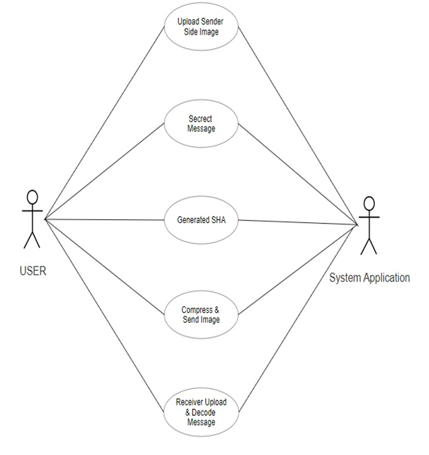
USECASE DIAGRAM

Slide 13
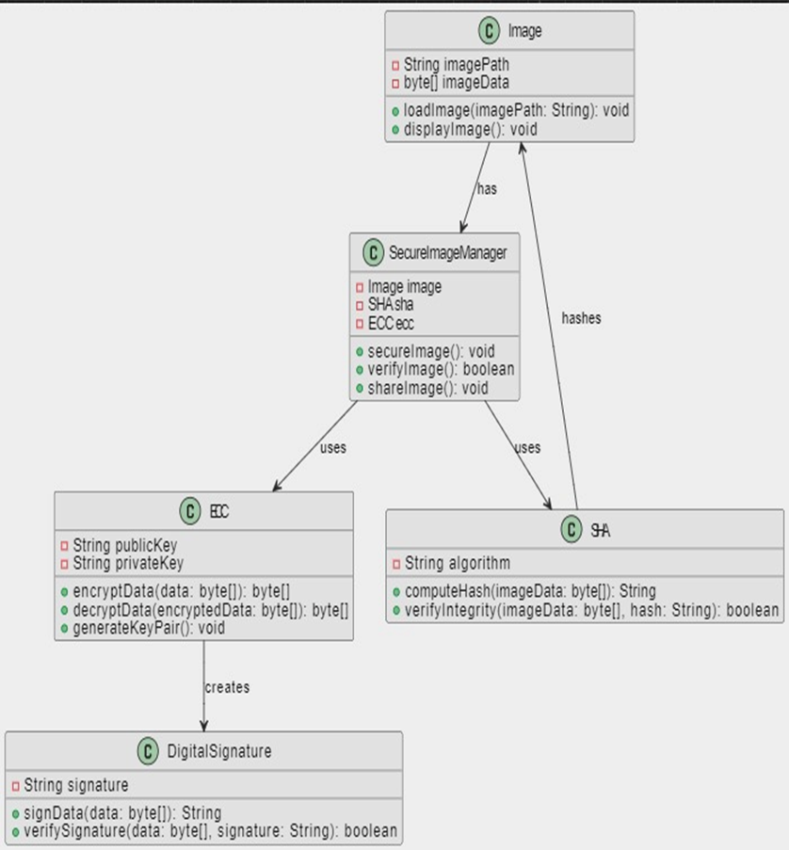
CLASS DIAGRAM

Slide 14
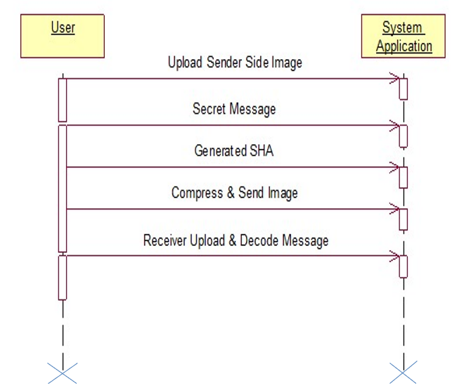
SEQUENCE DIAGRAM

Slide 15
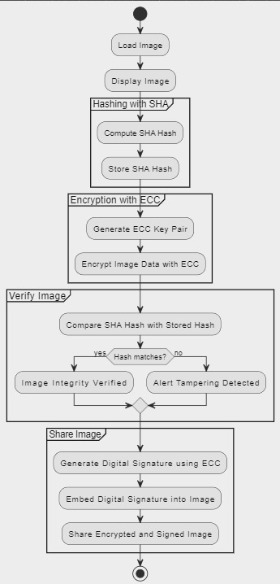
ACTIVITY DIAGRAM

Slide 16
SAMPLE CODE
from tkinter import messagebox
from tkinter import *
from tkinter import simpledialog
import tkinter
from tkinter import filedialog
from tkinter.filedialog import askopenfilename
from tkinter import ttk
import os
import numpy as np
from PIL import Image
import base64
from ecies.utils import generate_eth_key, generate_key
from ecies import encrypt, decrypt
import hashlib
import os
import zlib
main = Tk()
main.title("Securing data in the image using SHA & ECC")

Slide 17
main.geometry("1300x1200")
global filename, sender_sha
#function to generate public and private keys for ECC algorithm
def ECCGenerateKeys():
if os.path.exists("pvt.key"):
with open("pvt.key", 'rb') as f:
private_key = f.read()
f.close()
with open("pri.key", 'rb') as f:
public_key = f.read()
f.close()
private_key = private_key.decode()
public_key = public_key.decode()
else:
secret_key = generate_eth_key()
private_key = secret_key.to_hex() # hex string
public_key = secret_key.public_key.to_hex()
with open("pvt.key", 'wb') as f:
f.write(private_key.encode())
f.close()

Slide 18
with open("pri.key", 'wb') as f:
f.write(public_key.encode())
f.close()
return private_key, public_key
#ECC will encrypt data using plain text adn public key
def ECCEncrypt(plainText, public_key):
cpabe_encrypt = encrypt(public_key, plainText)
return cpabe_encrypt
#ECC will decrypt data using private key and encrypted text
def ECCDecrypt(encrypt, private_key):
cpabe_decrypt = decrypt(private_key, encrypt)
return cpabe_decrypt
def Encode(src, message):
global sender_sha
img = Image.open(src, 'r')
width, height = img.size
array = np.array(list(img.getdata()))
if img.mode == 'RGB':
n = 3
elif img.mode == 'RGBA':
n = 4

Slide 19
total_pixels = array.size//n
message = message.encode()
private_key, public_key = ECCGenerateKeys()
ecc_encrypt = ECCEncrypt(message, public_key)
sha = hashlib.sha256(ecc_encrypt)
sender_sha = sha.hexdigest()
tf2.insert(0, sender_sha)
message = base64.b64encode(ecc_encrypt).decode()
b_message = ''.join([format(ord(i), "08b") for i in message])
req_pixels = len(b_message)
if req_pixels > total_pixels:
print("ERROR: Need larger file size")
else:
index=0
for p in range(total_pixels):
for q in range(0, 3):
if index < req_pixels:
array[p][q] = int(bin(array[p][q])[2:9] + b_message[index], 2)
index += 1
array=array.reshape(height, width, n)

Slide 20
enc_img = Image.fromarray(array.astype('uint8'), img.mode)
enc_img.save("ReceivedCompressImages/"+"Compressed_"+os.path.basename(src))
with open("ReceivedCompressImages/"+"Compressed_"+os.path.basename(src), "rb") as file:
data = file.read()
file.close()
huffmancompress = zlib.compress(data)
with open("ReceivedCompressImages/"+"Compressed_"+os.path.basename(src), "wb") as file:
file.write(huffmancompress)
file.close()
text.insert(END,"ECC Cipher Text : "+str(message)+"\n")
text.insert(END,'Compress Image Saved Inside "ReceivedCompressImages" folder\n')
def Decode(src):
text.delete('1.0', END)
with open(src, "rb") as file:
data = file.read()
file.close()
data = zlib.decompress(data)
with open("decompress.png", "wb") as file:
file.write(data)
file.close()

Slide 21
font1 = ('times', 13, 'bold')
uploadButton = Button(main, text="Upload Sender Side Image", command=uploadSenderImage)
uploadButton.place(x=50,y=100)
uploadButton.config(font=font1)
l1 = Label(main, text='Secret Message')
l1.config(font=font)
l1.place(x=50,y=150)
tf1 = Entry(main,width=50)
tf1.config(font=font)
tf1.place(x=220,y=150)
l2 = Label(main, text='Generated SHA')
l2.config(font=font)
l2.place(x=50,y=200)
tf2 = Entry(main,width=70)
tf2.config(font=font)
tf2.place(x=220,y=200)
sendButton = Button(main, text="Compress & Send Image", command=sendImage)
sendButton.place(x=50,y=250)
sendButton.config(font=font1)

Slide 22
decodeButton = Button(main, text="Receiver Upload & Decode Message", command=decodeMessage)
decodeButton.place(x=290,y=250)
decodeButton.config(font=font1)
font1 = ('times', 13, 'bold')
text=Text(main,height=20,width=120)
scroll=Scrollbar(text)
text.configure(yscrollcommand=scroll.set)
text.place(x=10,y=300)
text.config(font=font1)
main.config(bg='cornflower blue')
main.mainloop()

Slide 23
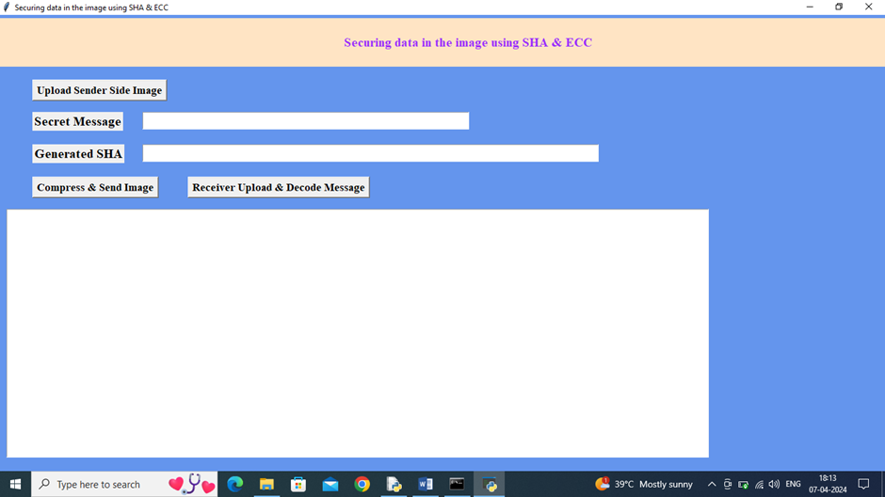

RESULTS
Upload Sender Side Image
uploading ‘src.png’

Slide 24
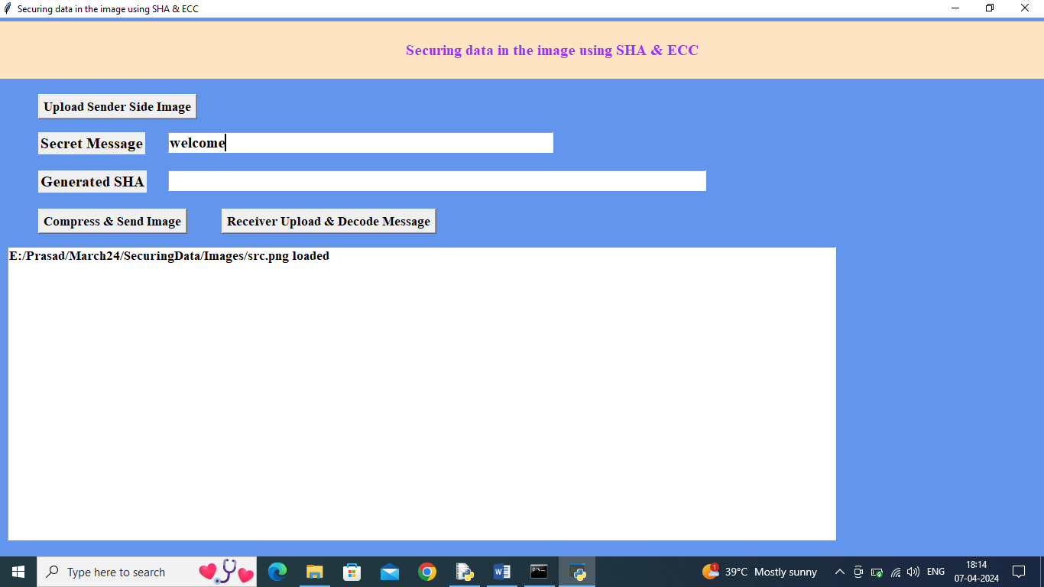
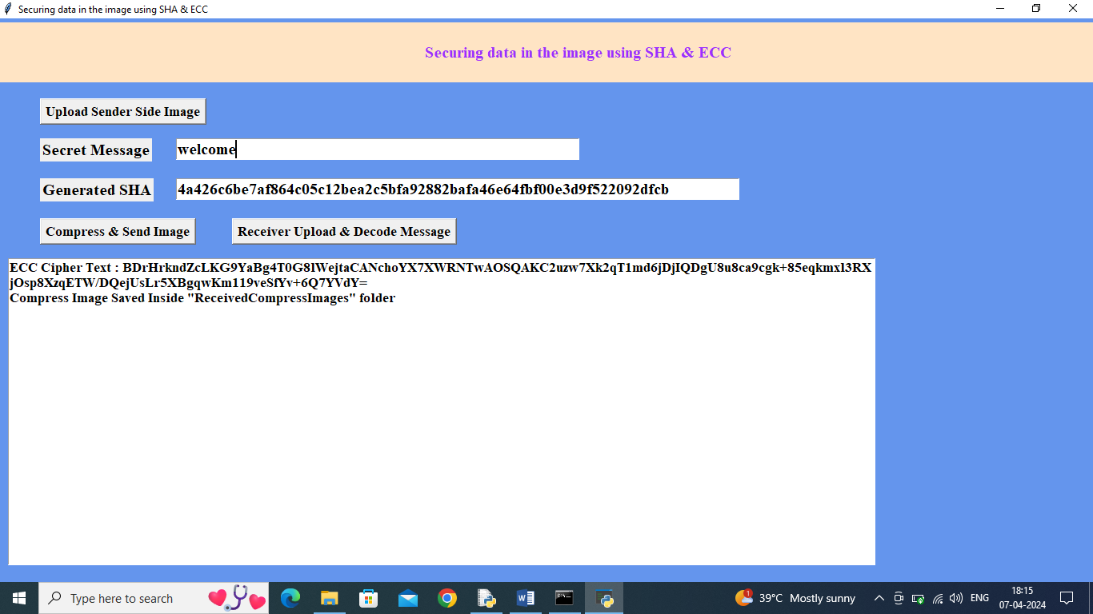
Enter Secret Message Compress & Send Image

Slide 25


Compressed image Original Image

Slide 26
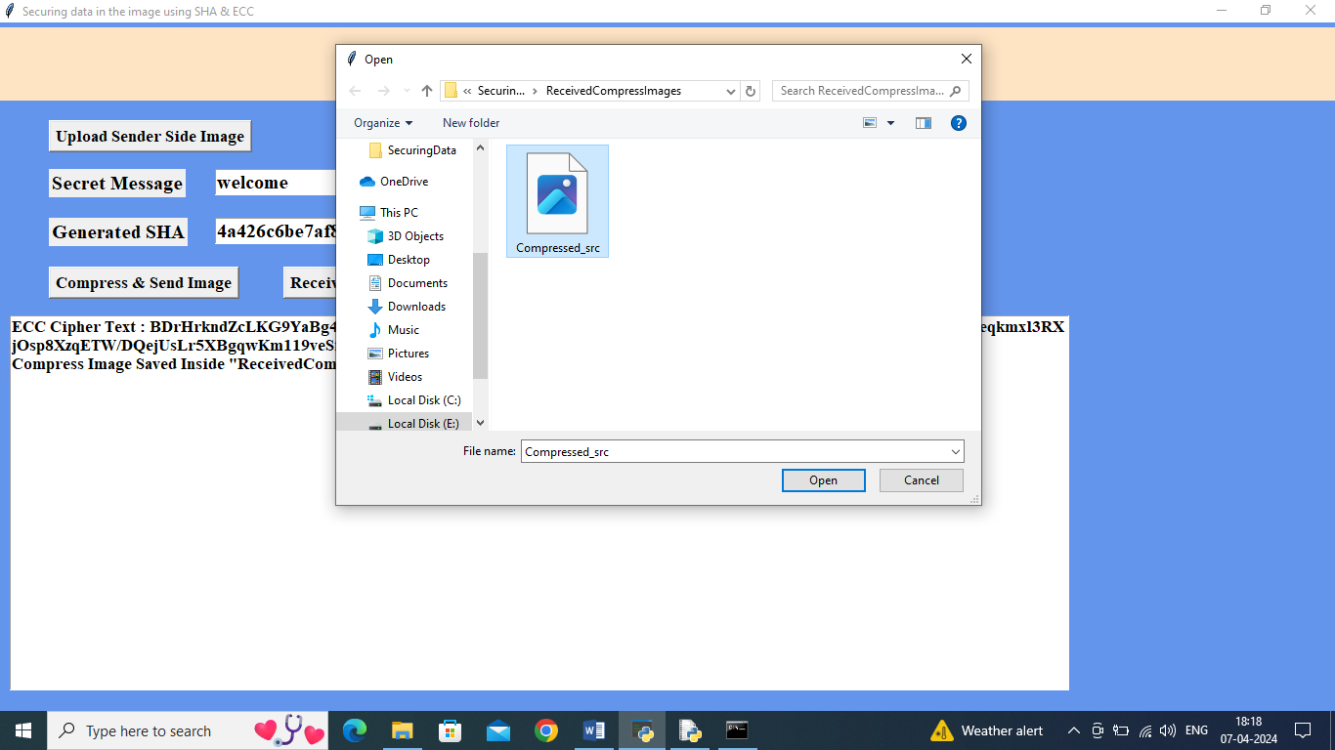

Uploading compress image Decrypted hidden message

Slide 27
CONCLUSION
In conclusion, securing data in images using SHA (Secure Hash Algorithm) and ECC (Elliptic Curve Cryptography) provides a robust approach to ensuring data integrity and confidentiality. SHA algorithms, such as SHA-256, generate a unique hash value that verifies the integrity of the image data, making it resistant to tampering or unauthorized alterations. ECC, on the other hand, offers strong encryption with relatively smaller key sizes compared to traditional methods, ensuring efficient yet secure data encryption and decryption. Together, these technologies enhance the security of digital images, safeguarding sensitive information against various threats and maintaining trust in the authenticity and confidentiality of the data. Implementing these cryptographic techniques not only fortifies data protection but also supports compliance with stringent security standards, making it a crucial practice for safeguarding digital assets in an increasingly digital world.

Slide 28
FUTURE SCOPE
The future scope of a project focused on securing data in images using SHA (Secure Hash Algorithm) and ECC (Elliptic Curve Cryptography) is both promising and multifaceted. As digital image data becomes increasingly integral to various applications, including social media, medical imaging, and national security, the need for robust data protection mechanisms grows. The use of SHA can ensure the integrity of image data by generating unique hash values that detect any tampering or corruption. On the other hand, ECC offers efficient and strong encryption for safeguarding sensitive information embedded within images, making it ideal for devices with limited processing power.

Slide 29
REFERENCES
Zhou, H., & Zhang, X. (2015). "An image authentication scheme based on SHA-256 and ECC." Journal of Computer Security, 23(3), 305-323.
Huang, X., & Chen, Y. (2017). "Data hiding and authentication using SHA-3 and ECC in digital images." IEEE Transactions on Information Forensics and Security, 12(7), 1765-1776.
Ghosh, S., & Sinha, R. (2016). "A hybrid approach of ECC and SHA-2 for secure image encryption and authentication." International Journal of Network Security, 18(5), 772-783.
Singh, V., & Choudhury, R. (2018). "Image watermarking and authentication using ECC and SHA-1." Journal of Cryptographic Engineering, 8(4), 345-359.

Slide 30
GIT-HUB LINK
https://github.com/karthikreddy9676/SECURING-DATA-IN-THE-IMAGE-SHA-and-ECC-

Slide 31
THANK YOU…

